Slide 1
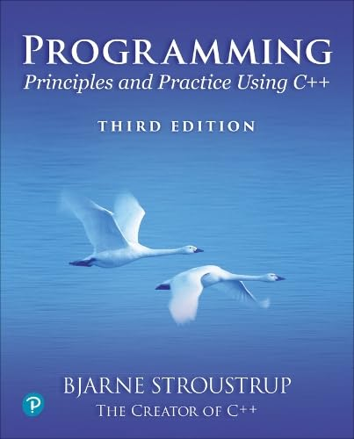
Chapter 13 – Graphing Functions and Data
The best is the enemy of the good.
– Voltaire

Slide 2
TBD

