Slide 1
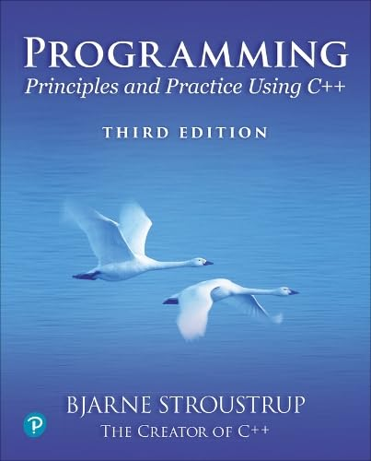
Chapter 21 - Algorithms
In theory, practice is simple.
– Trygve Reenskaug

Slide 2
TBD

